Slide 1
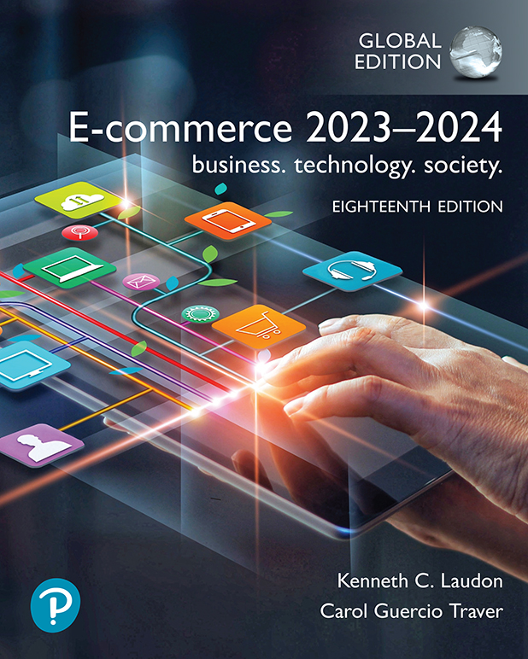
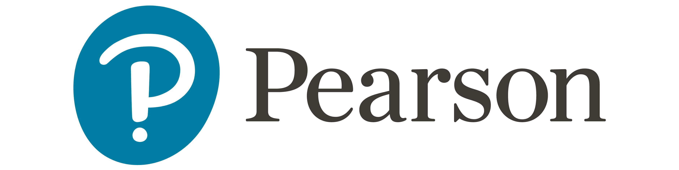
E-commerce 2023–2024: business. technology. society.
Eighteenth Edition
Chapter 5
E-commerce Security and Payment Systems
© 2023 Pearson Education Ltd. All Rights Reserved
Notes:
If this PowerPoint presentation contains mathematical equations, you may need to check that your computer has the following installed:
1) MathType Plugin
2) Math Player (free versions available)
3) NVDA Reader (free versions available)

Slide 2
Learning Objectives
5.1 Understand the scope of e-commerce crime and security problems, the key dimensions of e-commerce security, and the tension between security and other values.
5.2 Identify the key security threats in the e-commerce environment.
5.3 Appreciate the importance of policies, procedures, and laws in creating security.
5.4 Identify the major e-commerce payment systems in use today.

Slide 3
The E-commerce Security Environment
Scope of the problem
Overall size of and losses due to cybercrime unclear
Center for Strategic and International Studies study: Global economic impact of cybercrime and cyberespionage more than $1 trillion; other researchers believe the amount is even higher
IBM Security & Ponemon Institute 2021 Cost of Data Breach Report: total average cost of a data breach globally was $4.2 million, 2024 was $4.88
Underground economy marketplaces sell stolen information, malware and more

Slide 4
What Is Good E-commerce Security?
To achieve highest degree of security, use:
New technologies, e.g., encryption, MFA
Organizational policies and procedures, e.g., No-Password Sharing Policy
Industry standards and government laws, e.g., GDPR
Other factors
Time value of money/information
Cost of security versus potential loss
Security often breaks at weakest point

Slide 5
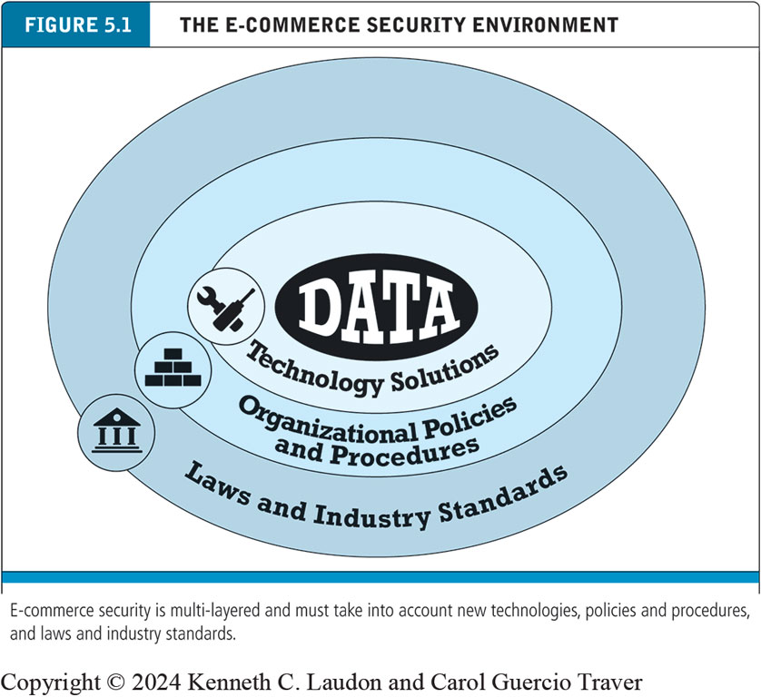
Figure 5.1 The E-commerce Security Environment
Notes:
Figure 5.1, Page 245.
E-commerce security is multi-layered, and must take into account new technology, policies and procedures, and laws and industry standards.
Alt Text:
The illustration consists of four concentric layers. The layers from innermost to outermost are labeled as follows. Data. Technology solutions. Organizational policies and procedures. Laws and industry standards.

Slide 6
Table 5.3 Customer and Merchant Perspectives on the Different Dimensions of E-commerce Security
Dimension | Customer’s Perspective | Merchant’s Perspective
Integrity | Has information I transmitted or received been altered? | Has data been altered without authorization? Is data being received from customers valid?
Nonrepudiation | Can a party to an action with me later deny taking the action? | Can a customer deny ordering products?
Authenticity | Who am I dealing with? How can I be assured that the person or entity is who they claim to be? | What is the real identity of the customer?
Confidentiality | Can someone other than the intended recipient read my messages? | Are messages or confidential data accessible to anyone other than those authorized to view them?
Privacy | Can I control the use of personal information that I am transmitting to an e-commerce merchant? | Is the personal information of customers being used in an unauthorized manner?
Availability | Can I access to site or app? | Is the site or app operational?
Notes:
The essential security requirements in the design of electronic payment systems for safe electronic payments, and to protect both the buyer and the merchant from fraud, data breaches, and unauthorized access. are:
Authentication
is the process of verifying the identity of the parties involved in the transaction. Typically, the payer, before authorizing a payment (e.g., 2FA /OTP)
Encryption
A process of making messages unreadable except by those who have an authorized decryption key. HTTPS ensures that credit card details, login credentials, and other sensitive data are encrypted.
Integrity
Ensuring that information will not be intentionally or unintentionally altered or destroyed during transmission. such as payment details and transaction amounts
Non repudiation
Protection against customer’s denying the orders placed and against merchant’s denying the payments made.

Slide 7
The Tension Between Security and Other Values
Security is not an unmitigated good.
Tensions between security and ease of use
The more security measures added, the more difficult a site is to use, and the slower it becomes
Too much security can harm profitability; not enough can put a business out of business
Possible solution: adaptive approach to security
Segment users by risk profile
Adjust security settings to users’ preferences

Slide 8
Security Threats in the E-commerce Environment
Three key points of vulnerability in e-commerce environment
Client
Server
Communications pipeline (Internet communications channels)

Slide 9
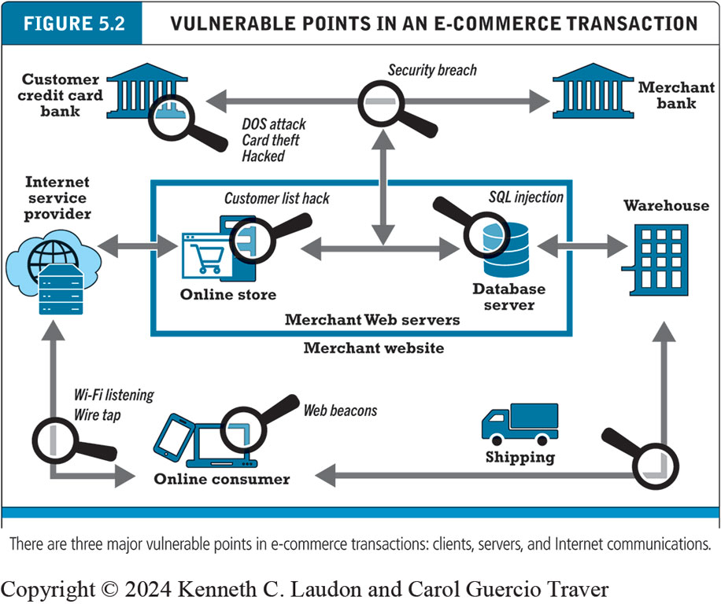
Figure 5.2 Vulnerable Points in an E-commerce Transaction
Distributed Denial of Service Attack
Notes:
Figure 5.2, Page 248.
There are three major vulnerable points in e-commerce transactions: Internet communications, servers, and clients.
Alt Text
Long description: The online consumer computer is vulnerable to web beacons. The connection between the online consumer and internet service provider is vulnerable to WI FI listening and wire taps. The online store and database servers are part of the merchant website run by merchant web servers. The online store, which is connected on one side to to the internet service provider and on the other side to the database server, is vulnerable to a customer list hack. The database server, which is connected on one side to the online store and on the other side to the warehouse, which is also connected to shipping, is vulnerable to an S Q L injection attack. The customer credit card bank is vulnerable to a D O S attack, card theft, or other hack. The connection between the customer credit card bank and the merchant bank is vulnerable to a security breach that also impacts the online store.

Slide 10
Malicious Code/Malware
Exploits and exploit kits
Drive-by downloads
Malvertising
Viruses, with user intervention e.g., open word file
Worms, without user intervention
Ransomware, encrypting your files
Trojan horses, e.g., useful programs- Game Cracker
Backdoors

Slide 11
Potentially Unwanted Programs
Also referred to as potentially unwanted applications.
Include:
Browser parasites
Monitor and change user’s browser
Can be used for cryptojacking
Adware
Used to call pop-up ads
Spyware
Tracks users’ keystrokes, e-mails, I M s, etc.

Slide 12
Phishing
Any deceptive, online attempt by a third party to obtain confidential information for financial gain
Tactics
Social engineering, e.g., scammer call
E-mail scams and B E C phishing
Spear phishing/directed, specific individuals or entities, using personal information to make the message more convincing. LinkedIn
Used for identity fraud and theft
B E C: Business Email Compromise

Slide 13
Credit Card Fraud/Theft
One of most feared occurrences, despite federal law limits on liability
Systematic hacking and looting of corporate servers is primary cause
Central security issue: establishing customer identity
E-signatures
Multi-factor authentication
Fingerprint identification

Slide 14
Identity Fraud/Theft
Unauthorized use of another person’s personal data for illegal financial benefit
Social security number
Driver’s license
Credit card numbers
Usernames/passwords
2021: About 15 million U.S. consumers suffered identity fraud

Slide 15
Insider Attacks
Biggest financial threat to businesses comes from insider embezzlement
Employee access to privileged information
Poor security procedures
Insiders more likely to be source of cyberattacks than outsiders

Slide 16
Social Network Security Issues
Social networks an environment for:
Viruses, site takeovers, identity fraud, malware-loaded apps, click hijacking, phishing, spam
Twitter hack used social engineering to take control of dozens of prominent accounts and post Bitcoin scam
Manual sharing scams
Sharing of files that link to malicious sites
Fake offerings, fake Like buttons, and fake apps

